Slide 1

DATA COMPRESSION
ANU YADAV

Slide 2

COMPRESSION
IT A Data Compression, this is a process of reducing the amount of data required to represent a given quantity of information.
It is used in computer graphics, multimedia, data structure & algo, DBMS, and information theory and coding.
Video file : 1Gb (uncompressed) and timing 1hr 30 min – 250 Mb, this compressed – I m using less of bits - 1hr 30 min (time will remain same)
Data compression tech: Lossless and lossy

Slide 3
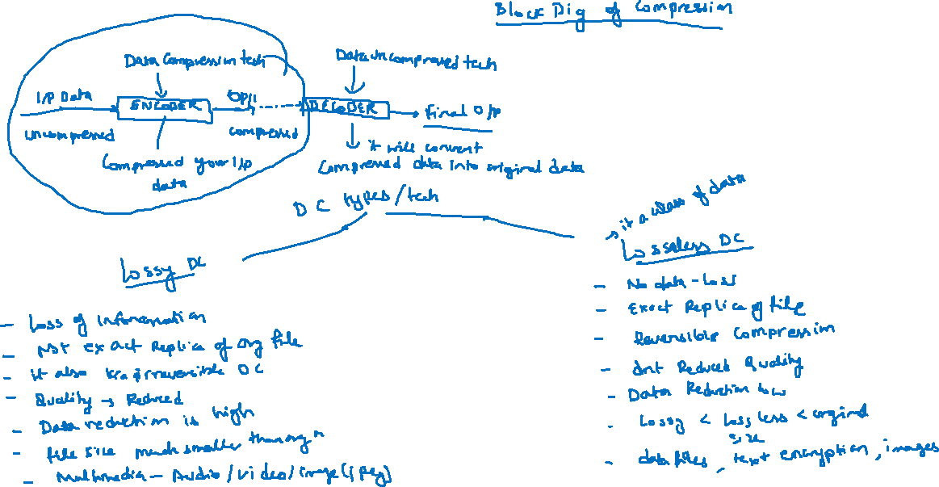

Slide 4
Lossless compression: it is a class of data compression type that allows the original data to be perfectly reconstructed from the compressed data
Lossy compression: it is a class of data compression type that permits reconstruction of an approximate of original data file with improved compression rate.
Compression ratio; the ratio of compressed data divided by original size.
CR = Compressed size/original size = 250 mb/1gb = ¼.
Compression factor (CF) : it is the inverse of compression ratio
CF = 1/ CR = 4/1 = 4
Compression time: the total time taken by encoder to compress the input data into output data> time to compress
It is denoted by milli sec
Decompression time: the total time taken by decoder to decompress

Slide 5
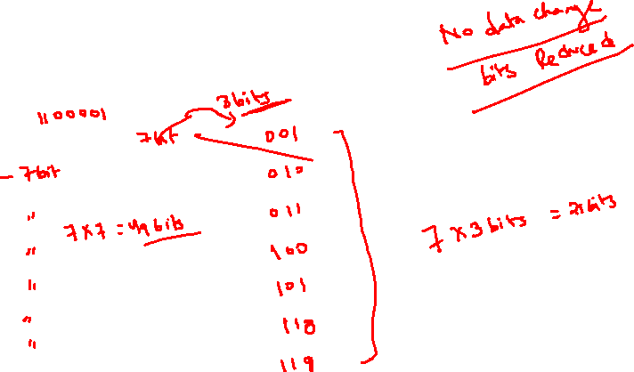
Fixed length encoding
A – ASCII CODE A > 97 A
B B
C C
D D
E E
F F
G G

Slide 6
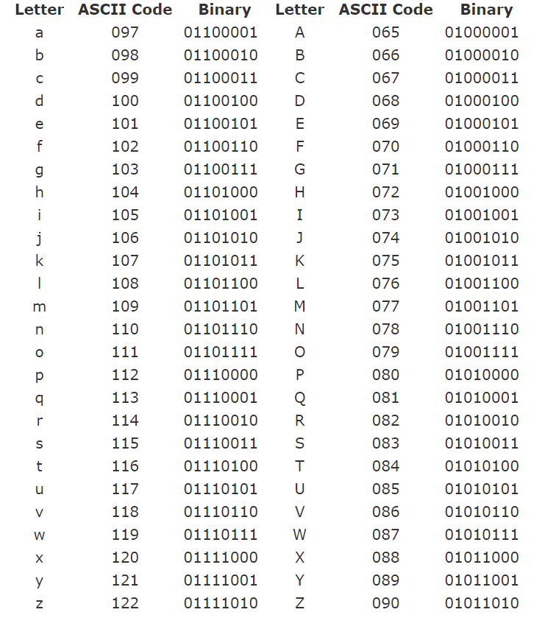

Slide 7
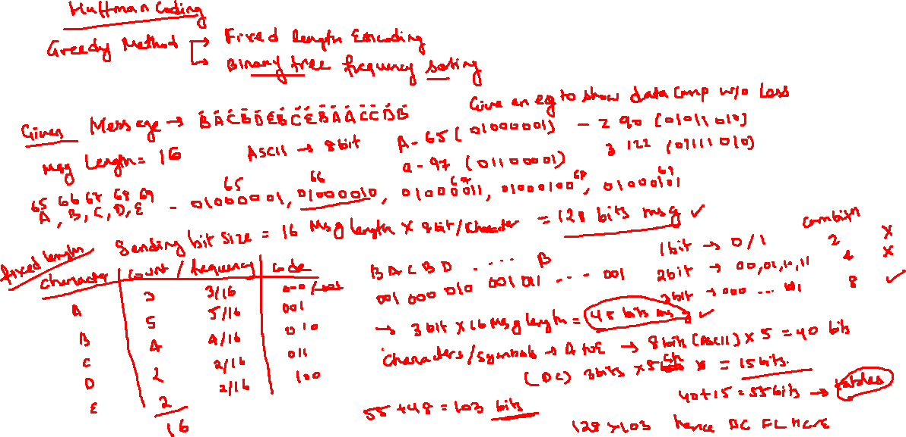

Slide 8
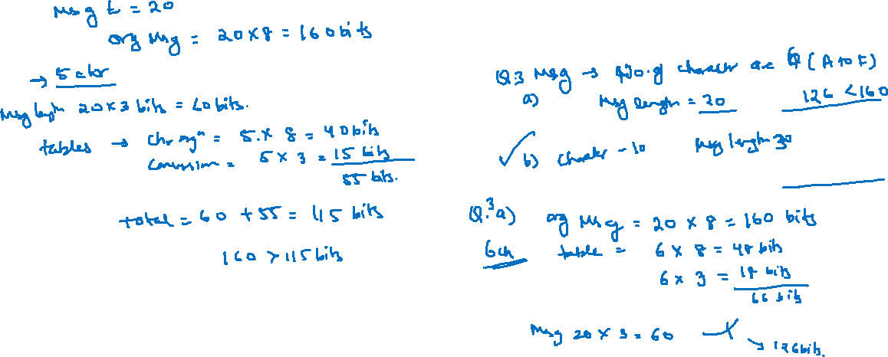

Slide 9
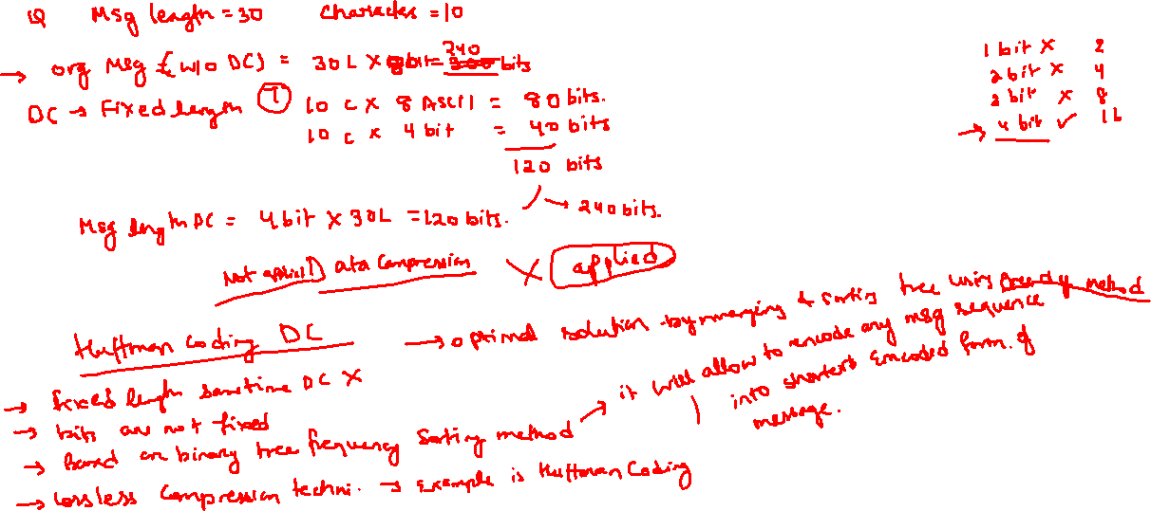

Slide 10
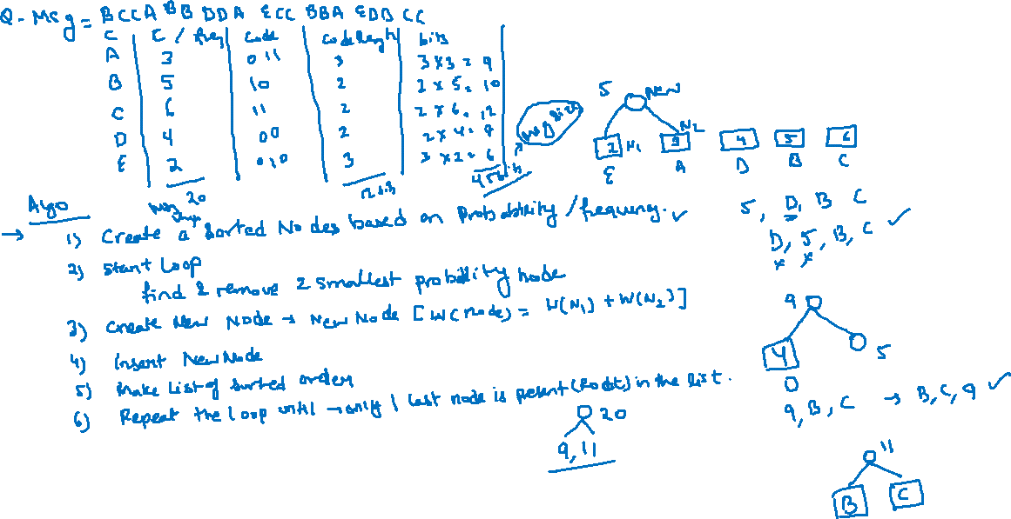

Slide 11
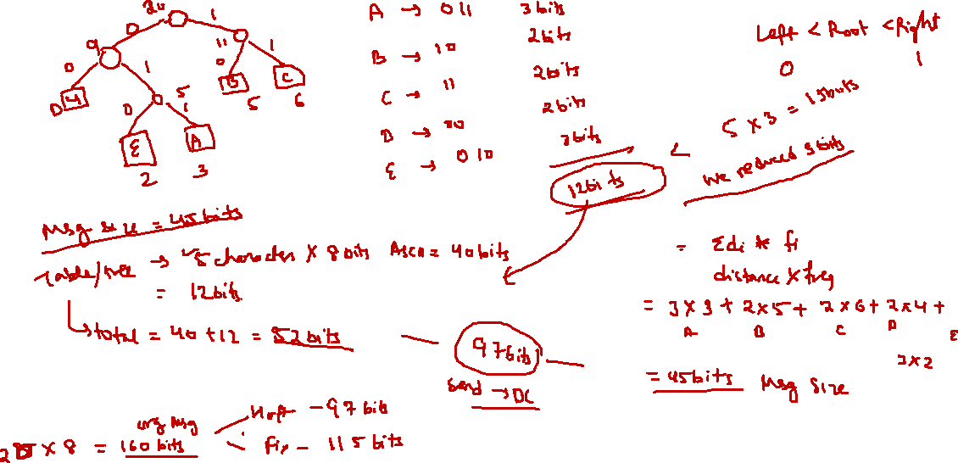
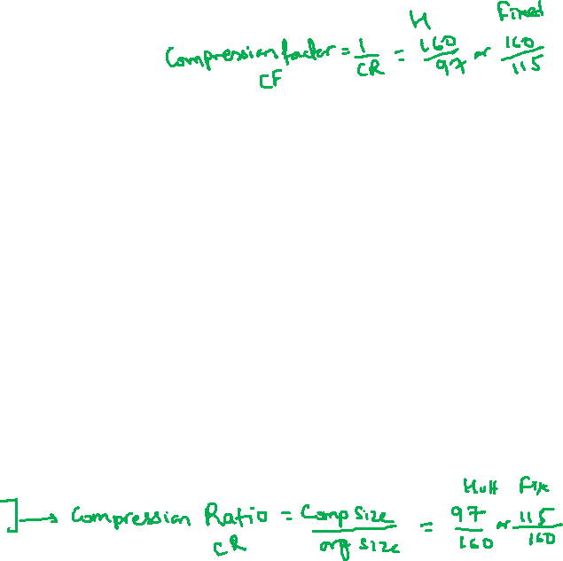

Slide 12
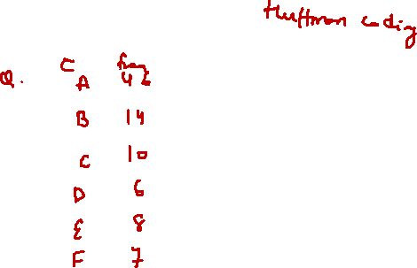
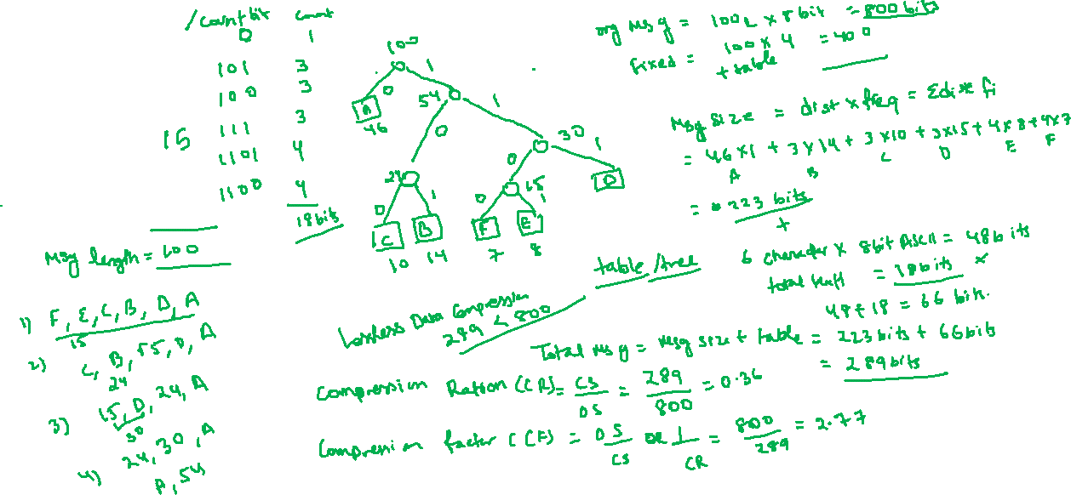

Slide 13
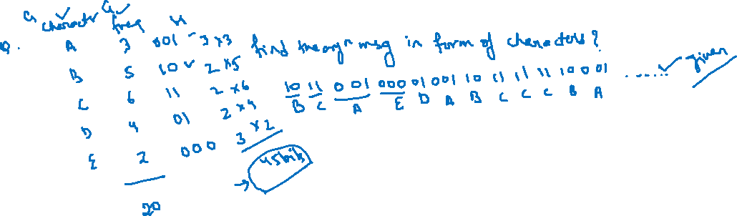

Slide 14
Lempel ziv coding or LZ Coding ( Data compression)
Lossless Data Compression Technique like Huffman coding
Compression is done by building a dictionary of previously seen strings. Perform coding of groups of characters of varying size/ lengths.
It is accomplished by passing the source data stream into segments that are shortest subsequence that dnt encountered previously
ALGO
Source sequence in sequentially parsed into strings that have not appeared so far.
After every separation, look input sequence until we found shortest string which is not marked before.
Code this parse by giving the location prefix and value of last bit.

Slide 15
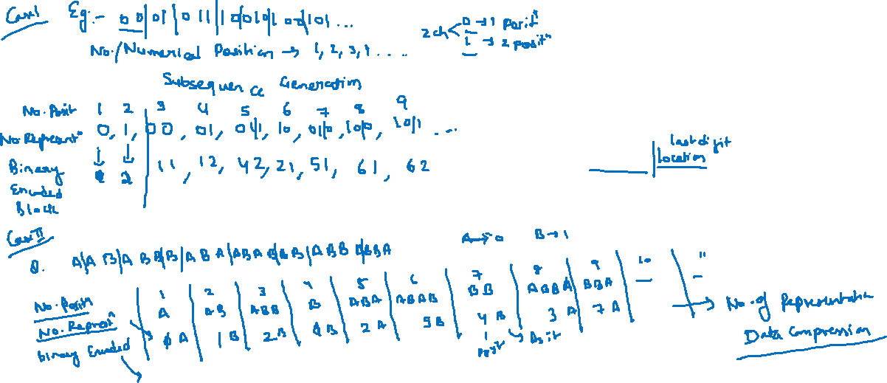
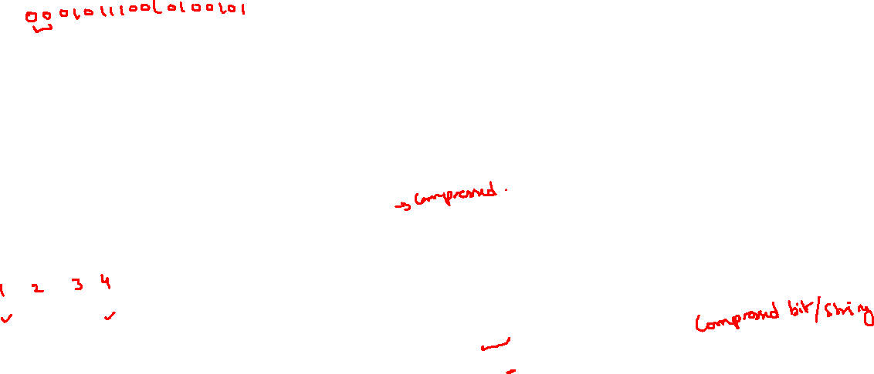

Slide 16
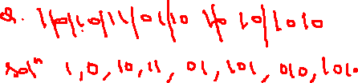
Dictionary Location | Number representation/ data compression | content | Codeword | Number position
001 | 1 | 1 | 0001 | 1
010 | 2 | 0 | 0000 | 2
011 | 12 | 10 | 0010 | 3
100 | 11 | 11 | 0011 | 4
101 | 21 | 01 | 0101 | 5
110 | 31 | 101 | 0111 | 6
111 | 52 | 010 | 1010 | 7
1000 | 62 | 1010 | 1100 | 8

Slide 17
QUE: 0,1,00,01,011,10,010,100
Dictionary Location | Number representation/ data compression | content | Codeword | Number position
001 | 1 | 0 | 0000 | 1
010 | 2 | 1 | 0001 | 2
011 | 11 | 00 | 0010 | 3
100 | 12 | 01 | 0011 | 4
101 | 42 | 011 | 1001 | 5
110 | 21 | 10 | 0100 | 6
111 | 41 | 010 | 1000 | 7
1000 | 61 | 100 | 1100 | 8

Slide 18
